Slide 1
Learning the Code
Eat, Sleep, Code, Repeat
Notes:
Check up to see if they are using the freecode camp, learning code apps mentioned in previous lesson.

Slide 2
Overview
Recap: What is Github?
Change Management / Version Control
How to create a repository and clone to your local environment
Git Branches and Commits

Slide 3
Recap: What is GitHub?

Slide 4

GitHub
A place where we can store our code and the history of the changes we have made.
It can also help with:
Code Reviews
Project Management
Integrations
Automation
Security

Slide 5
Change Management
Version Control / Source Control

Slide 6
Environments

Slide 7

Different Versions
There’s not just one version of an app or a website - there are many. Some versions we will be working on or testing out specific things, some may exist just as a backup - a safe place to ‘save game’ before we start something new.

Slide 8

Local Environment
You could run a local version of something on your computer

Slide 9

Production (LIVE) Environment
The version running on for people to see and use e.g. on a server as a live website

Slide 10
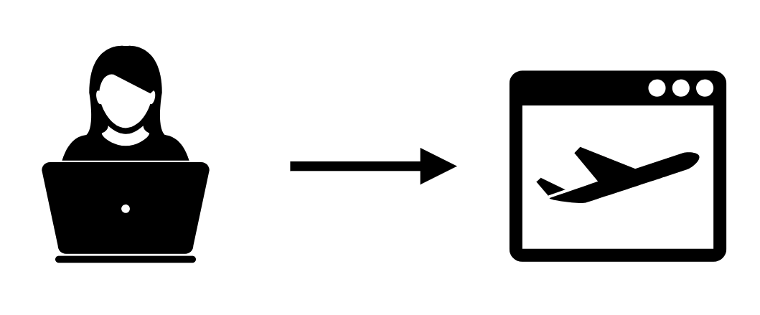
Single Developer Workflow
Do some work on your local version, test it and then deploy it to the live version

Slide 11
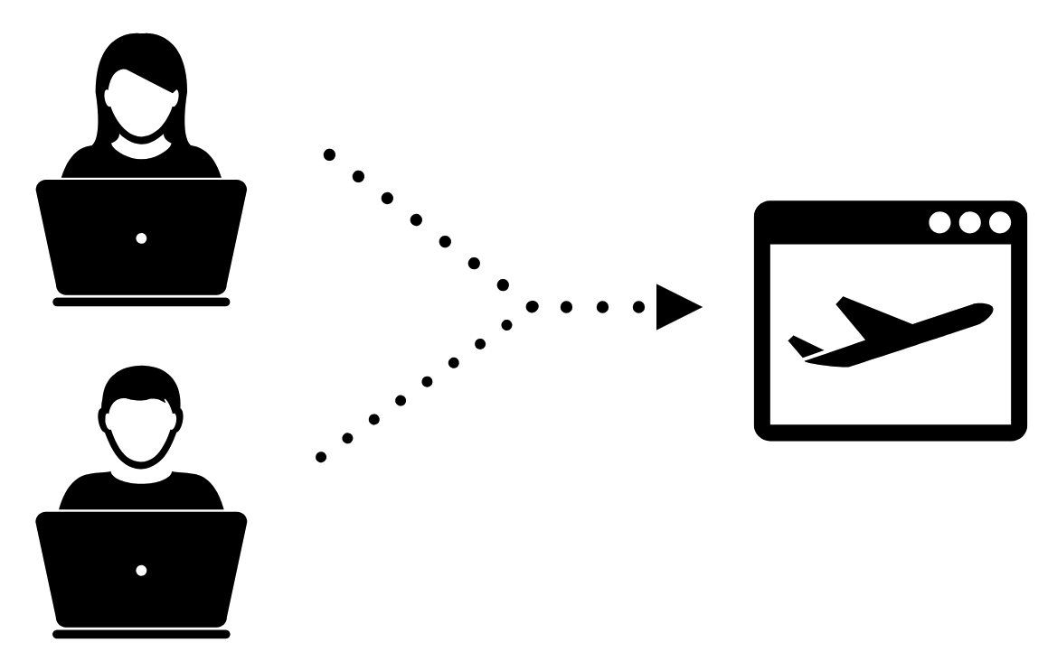
Multi-Developer Workflow
What happens when two people are working on the same code?

Slide 12
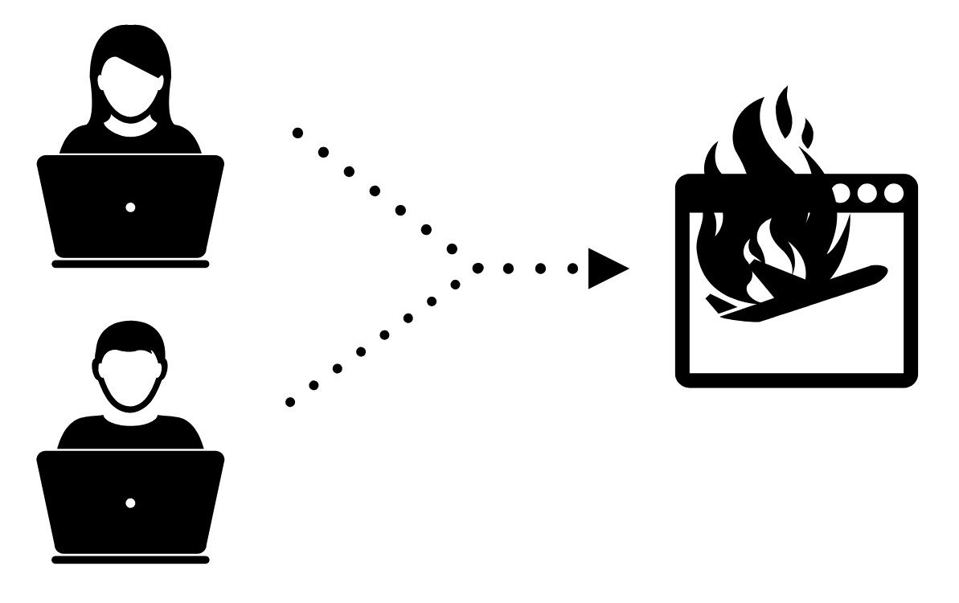
Multi-Developer Workflow
:(

Slide 13
Task 1.4.1
Open your CPD
Clone to your local, if you haven’t previously
Open in your code editor and create a folder called module-1.
Inside the folder module-1 add a HTML file - task-1.4.1.html
Copy text from CPD text file into your task-1.4.1.html file
Commit the change
Push to remote
Part 1 - Assisted Task
Notes:
This task could potentially be set up to be used in the HTML Module

Slide 14
Version Control FTW

Slide 15

Git
Git is a version control system.
It provides us with a ‘save game’ type history of all the revisions we have ever made to the code.
Every time we add, edit or delete some code or a file we add a message that says what we did and git also records exactly what changed.
Notes:
Git is like a really epic save button for your files and directories. Officially, Git is a version control system.

Slide 16
Branch and Commit
Branch
When we start a new piece of work - a new feature or issue we’ll create a branch.
A branch indicates a specific point where we started doing that work
When we have finished the work we can merge the branch back into the master code.
Commit
Whenever we change something in the code we commit - this is like a ‘save game’ a point in history we can get back to if needs be - or that will help us find out when or where something went wrong.
Commit as often as possible and always write a coherent accurate message to remind yourself and other devs what you did.

Slide 17
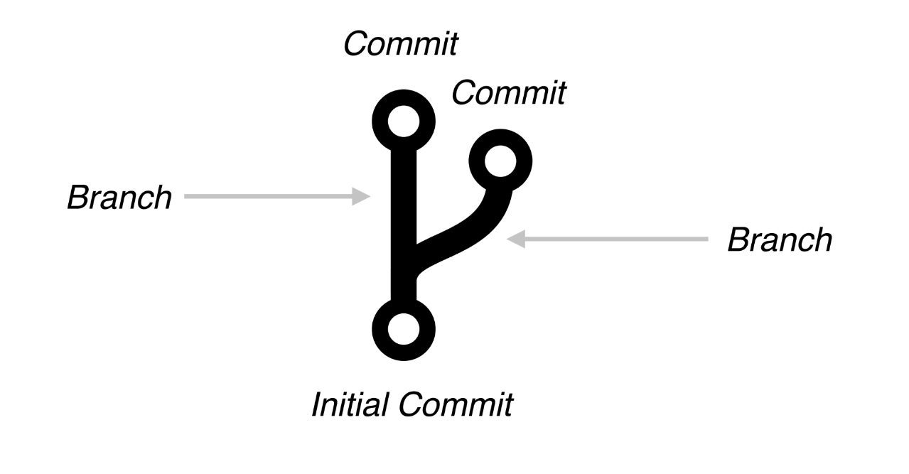
Git Branch

Slide 18
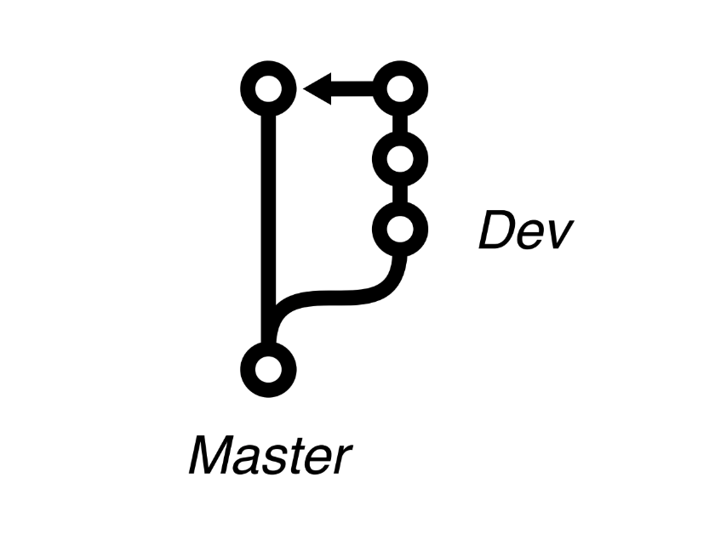
Git Branch
Sometimes branches are permanent and are attached to stages of a project or particular development environments.
Dev branch > Development server
Test Branch > Test Server
Master Branch > LIVE Server

Slide 19
Task 1.4.1
Student:
In your code editor open Task-1.4.1.html
Teacher Demo :
Add a h1 and paragraph tag
( Trainer to briefly Explain h1 / p tags )
Together :
Commit the change
Push to remote
Part 2 - Assisted Task

Slide 20
Demo:
Git Branch
Notes:
https://guides.github.com/introduction/flow/ and show the class how to create a branch using github desktop app

Slide 21
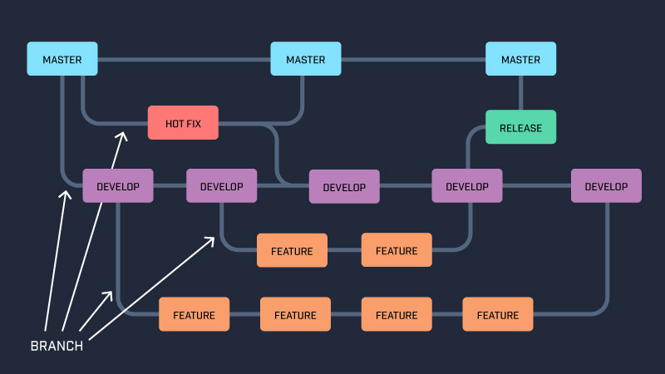
Visualising Git

Slide 22
REMINDER - This seems more complicated than it actually is
Notes:
This WILL NOT make sense straight away. We will learn by doing - keep repeating tasks and tutorials and it will slowly make sense.
This is a big hurdle for a lot of people but persevere and you will get through - It is really important.

Slide 23
Demo:
Repository on GitHub

Slide 24
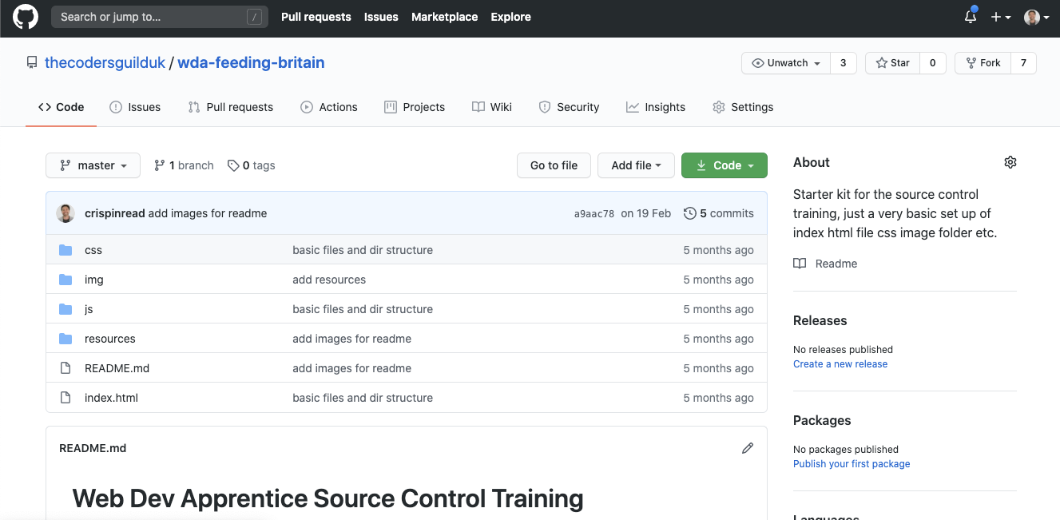
https://github.com/thecodersguilduk/wda-feeding-britain
Notes:
Info in the README file
Files and folders as you would expect to see when you clone or download
Check out the history - see the commit messages - they tell you about the developer’s thought process as they built the site

Slide 25
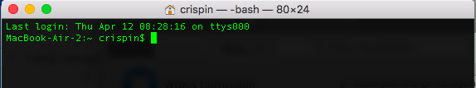
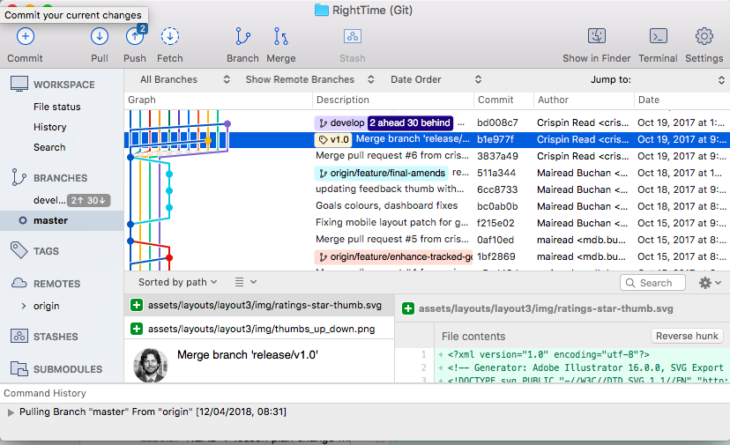
CLI Vs GUI
CLI
You can download git’s command-line interface (CLI) here
GUI
List of gui at :https://git-scm.com/

Slide 26

Group Task
Assisted Task
Change:
Take your <NAME>-CPD.txt file change to index.html
(*ALL lowercase filename*)
It should now be: index.html
Copy your text from task 1.4.1 and paste it into your newly formed <NAME>-CPD.html file
Notes:
Get students to remove their readme.md and show them how to make their index.html live ( using github pages )

Slide 27
Take away Tasks
Change:
Add a reflection of today’s lesson in your newly formed <NAME>-CPD.html
Watch :
HTML, CSS, JavaScript Explained
HTML vs. CSS: What’s the Difference

Slide 28
Questions?

